Slide 1


Malignant Comments Classifier Project
Submitted by: Dheerajkumar Pittala

Slide 2
Acknowledgement
I would like to thank FlipRobo Technologies for giving me the opportunity to work on this project. I am very grateful to DataTrained team for providing me the knowledge which helped me a lot to work on this project. Reference sources are:
1. Google
2. YouTube
3. TowardsDataScience
4. Stackoverflow
5. DataTrained Notes

Slide 3
Business Problem Framing
Introduction
The proliferation of social media enables people to express their opinions widely online. However, at the same time, this has resulted in the emergence of conflict and hate, making online environments uninviting for users. Although researchers have found that hate is a problem across multiple platforms, there is a lack of models for online hate detection.
Online hate, described as abusive language, aggression, cyberbullying, hatefulness and many others has been identified as a major threat on online social media platforms. Social media platforms are the most prominent grounds for such toxic behaviour.
There has been a remarkable increase in the cases of cyberbullying and trolls on various social media platforms. Many celebrities and influences are facing backlashes from people and have to come across hateful and offensive comments. This can take a toll on anyone and affect them mentally leading to depression, mental illness, self-hatred and suicidal thoughts.
Internet comments are bastions of hatred and vitriol. While online anonymity has provided a new outlet for aggression and hate speech, machine learning can be used to fight it. The problem we sought to solve was the tagging of internet comments that are aggressive towards other users. This means that insults to third parties such as celebrities will be tagged as unoffensive, but “u are an idiot” is clearly offensive.
Our goal is to build a prototype of online hate and abuse comment classifier which can used to classify hate and offensive comments so that it can be controlled and restricted from spreading hatred and cyberbullying

Slide 4
Conceptual Background of the Domain Problem
In the past few years its seen that the cases related to social media hatred have increased exponentially. The social media is turning into a dark venomous pit for people now a days. Online hate is the result of difference in opinion, race, religion, occupation, nationality etc.
In social media the people spreading or involved in such kind of activities uses filthy languages, aggression, images etc. to offend and gravely hurt the person on the other side. This is one of the major concerns now.
The result of such activities can be dangerous. It gives mental trauma to the victims making their lives miserable. People who are not aware of mental health online hate or cyber bullying become life threatening for them. Such cases are also at rise. It is also taking its toll on religions. Each day we can see an incident of fighting between people of different communities or religions due to offensive social media posts.
Online hate, described as abusive language, aggression, cyberbullying, hatefulness, insults, personal attacks, provocation, racism, sexism, threats, or toxicity has been identified as a major threat on online social media platforms. These kinds of activities must be checked for a better future.

Slide 5
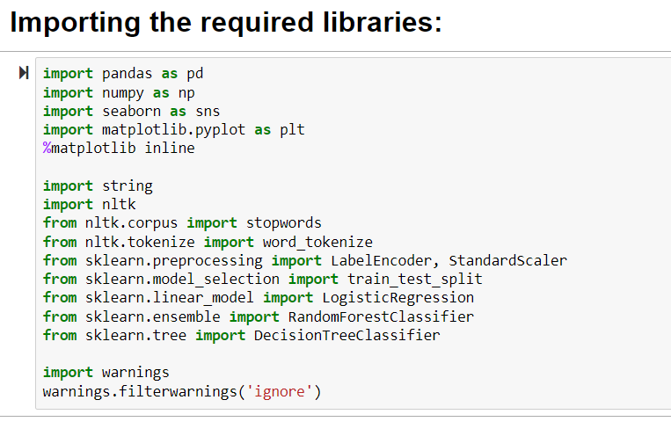
Loading Required Library Dataset

Slide 6
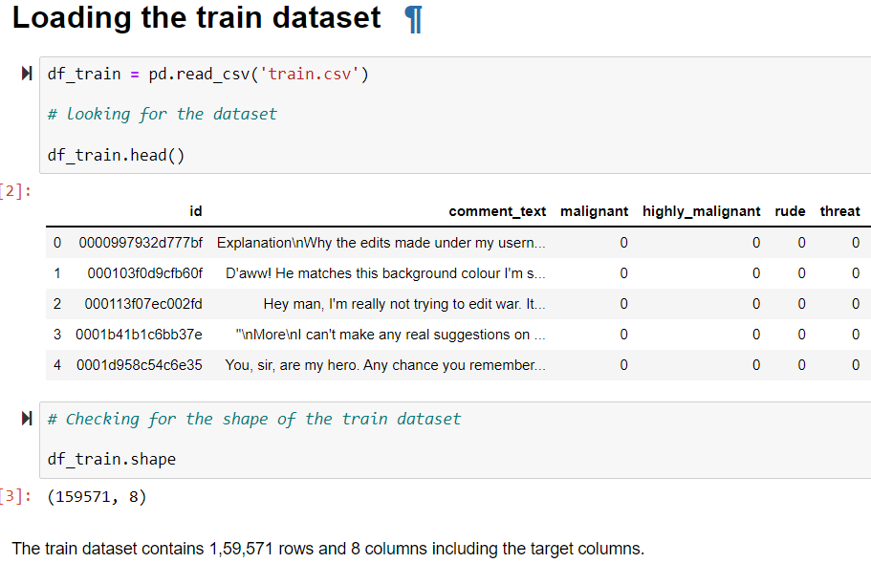
Loading Train Dataset

Slide 7
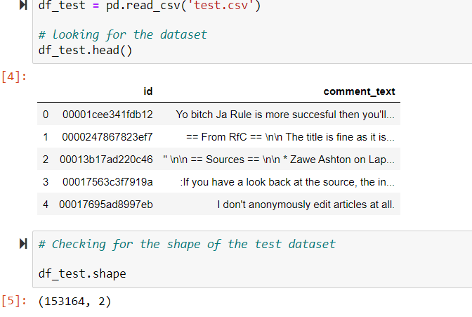
Loading the Test Dataset

Slide 8
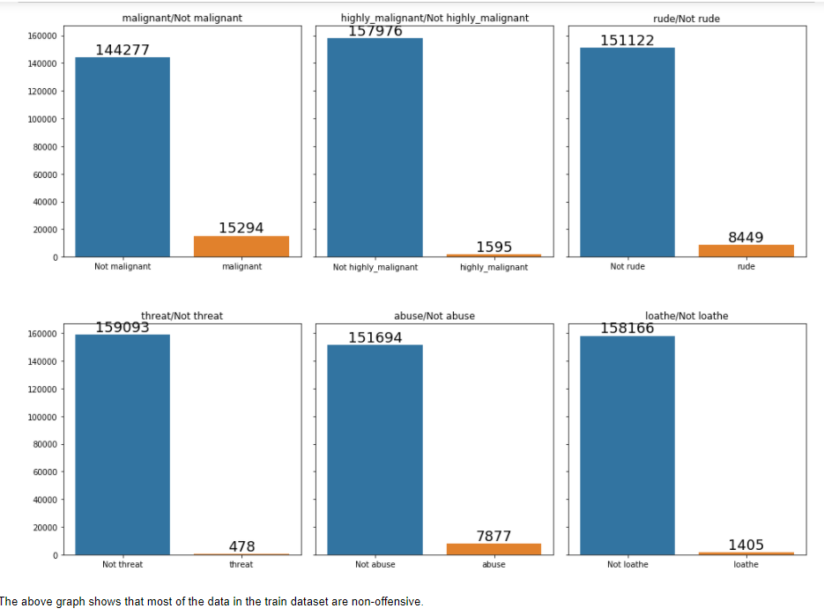
Data Visualization

Slide 9
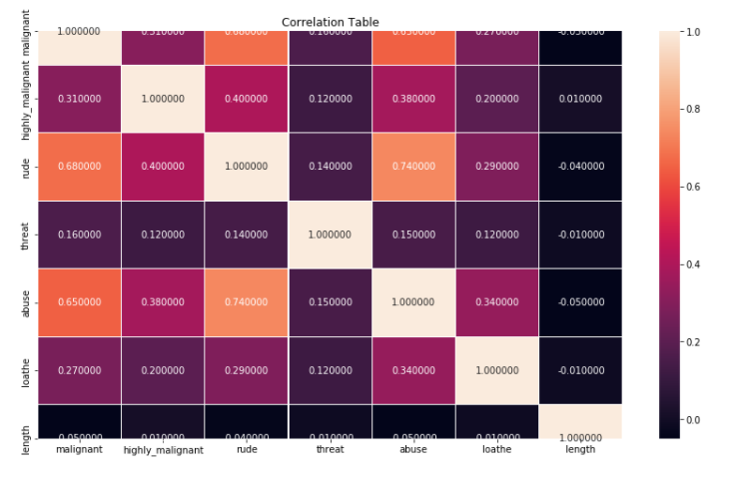
Checking for the Correlation Table

Slide 10
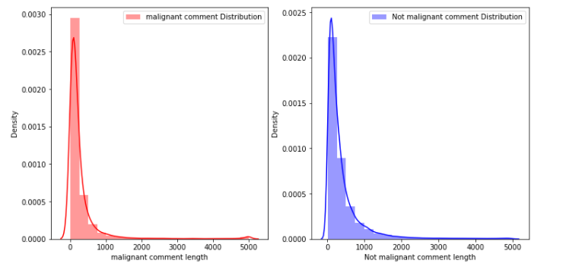
Let’s have a look at the distribution of comment before cleaning the comments

Slide 11
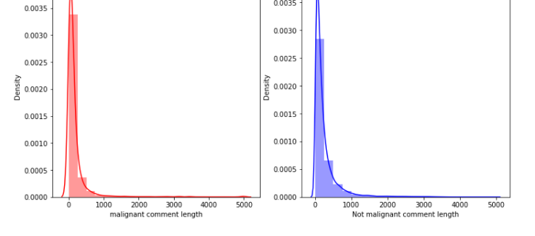
Distribution of comments after cleaning

Slide 12
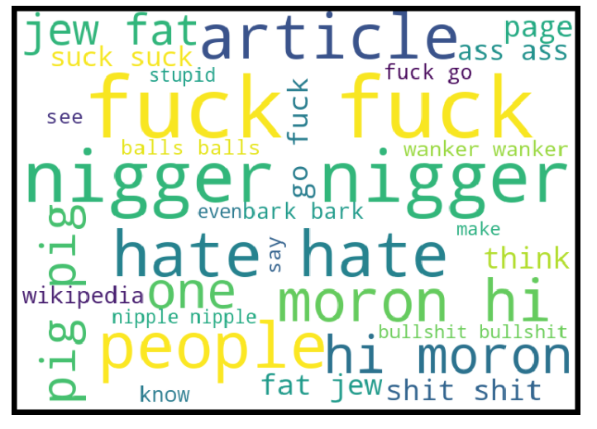
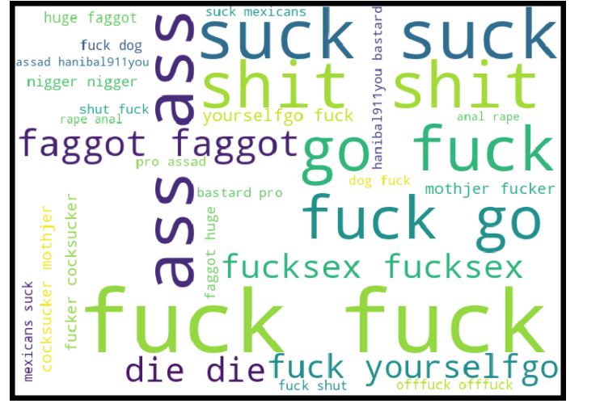
Let’s look at word cloud of Maglinant & highly maglinant Comments

Slide 13
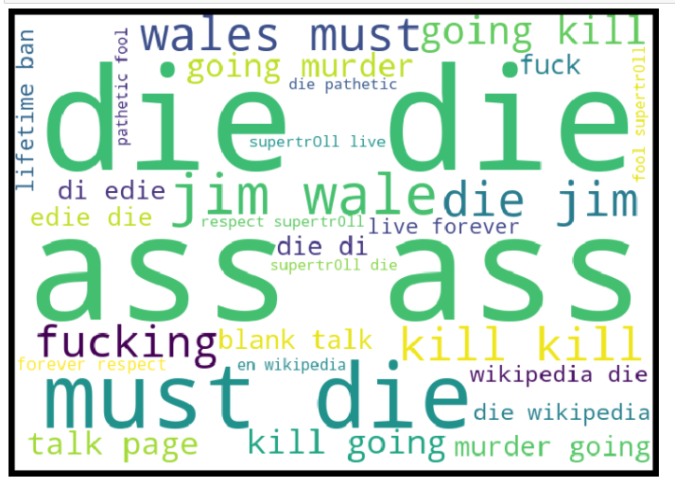
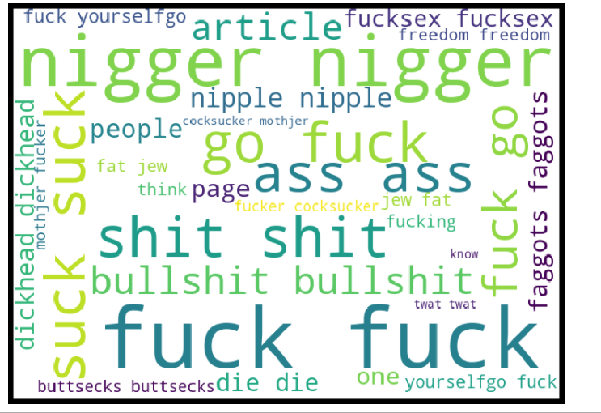
Let’s look at the word cloud of rude & threat comments

Slide 14
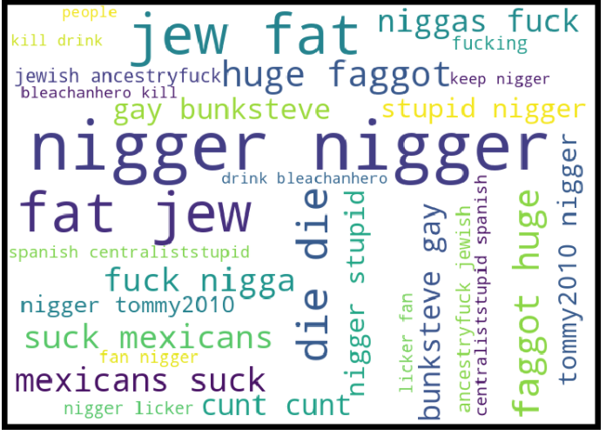
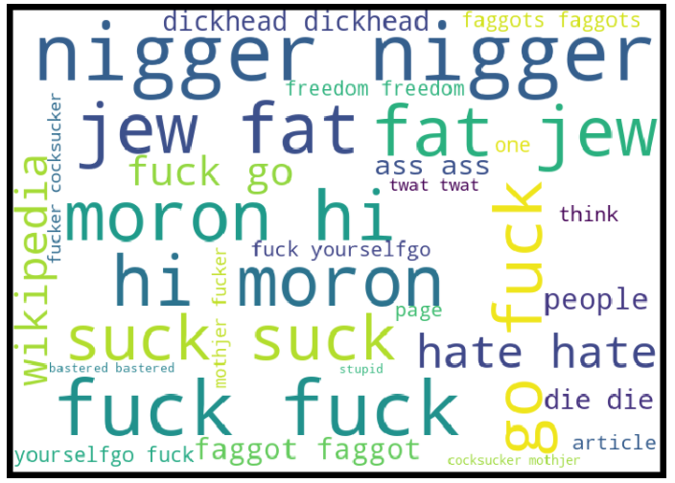
Let’s look at the word cloud of Abuse & loathe comments

Slide 15
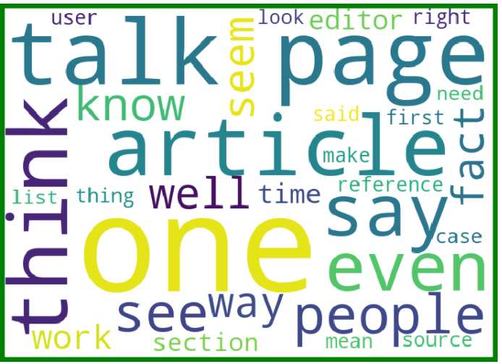
Let’s look at the word cloud not malignant comments

Slide 16

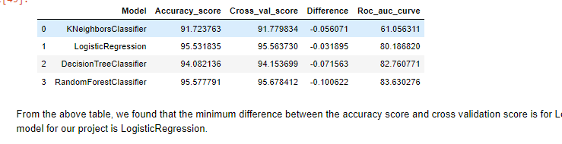
Results (Metrices) obtained from different ML algorithms

Slide 17
Key Findings
Online hate, described as abusive language, aggression, cyberbullying, hatefulness and many others has been identified as a major threat on online social media platforms. Social media platforms are the most prominent grounds for such toxic behaviour.
As a social media channel, we were able to filter out most of the comments as malignant with an accuracy score of 95% and AUC ROC score of 84%, which are decent numbers.
From the above analysis the below mentioned results were achieved which depicts the chances and conditions of a comment being a hateful comment or a normal comment.
With the increasing popularity of social media, more and more people consume feeds from social media and due differences they spread hate comments to instead of love and harmony. It has strong negative impacts on individual users and broader society.

Slide 18
Learning Outcomes of the Study in respect of Data Science
This project helped us to know the concepts of NLP and its application in the field of Data Science. This also helped me to sharpen my knowledge in the different classification models.

Slide 19
Limitations of this work and Scope for Future Work
There would be a lot of comments which will not be classified in this. For example, comments posted in languages other than English will not be classified by the model because the model was trained only in English language. Moreover, we would not be able to identify sarcasm and figure of speech, which again can be a malignant comment, but our machine cannot understand the same

Slide 20

Thank you

